Slide 1
Usage of Text in Multimedia
Transition from conventional media to digital media.

Slide 2
Usage of text in Multimedia
Definition of Text
• Text is words and symbols in any form, spoken or written, are the most common system of communication.
• Text is used in most Multimedia applications.
• With multimedia technology, text can be combined with other media in a powerful and meaningful way to present information and express moods.
• Text is the easiest to manipulate.

Slide 3
Usage of text in Multimedia
Text Elements
• Text elements can be categories into:
– Alphabets characters: A – Z
– Number: 0 – 9
– Special characters: . , ; : ‘ “
– Symbols: @ # $ & *

Slide 4
Usage of text in Multimedia
Text Usages
• Heading / Title
• Bullet / list
• Paragraph
• Scrolling text
• Navigation
• Text as graphics

Slide 5

Text Usages
Text as graphic
Heading
Navigation
Paragraph
5

Slide 6
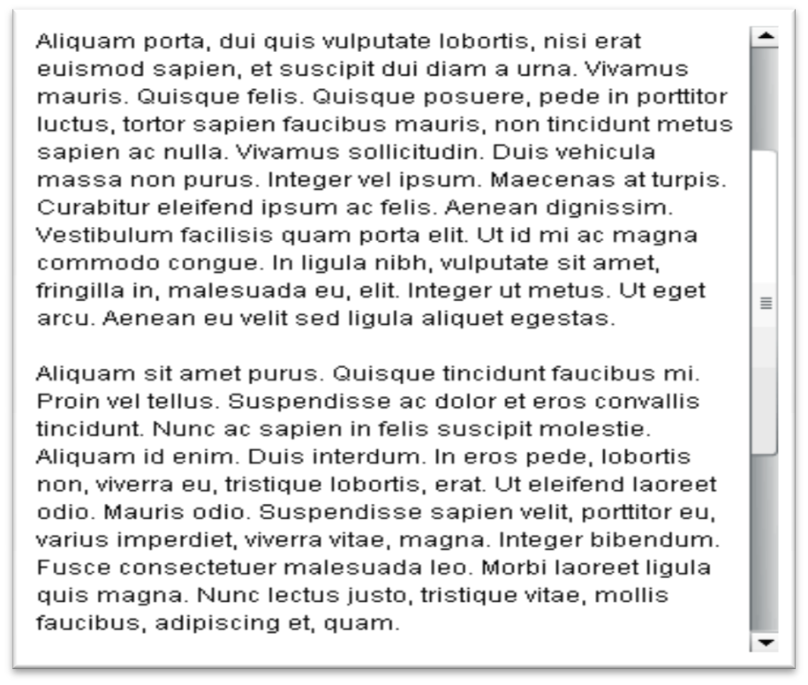
Usage of text in Multimedia

Slide 7
Transition from conventional media to digital media.
Digital marketing has the upper hand over traditional marketing in many ways. To learn how to transition from traditional to digital marketing, you should be aware of how digital works and what its benefits are.
How To Transition From Traditional Marketing to Digital Marketing:

Slide 8
Transition from conventional media to digital media.
Digital Marketing Characteristics
With digital, your marketing efforts can go global. That’s the defining characteristic of digital marketing, and it makes it so compelling. You don’t have to rely on direct mail, TV and print ads, and pray that your message reaches your target audience. Nowadays, when it’s easier for consumers than ever to skip an advertisement they aren’t interested in, traditional marketing becomes more obsolete.
As opposed to that, digital marketing keeps up with the technological times. It aims to target only the right consumers, using very specific and accurate metrics which take demographics into account. There’s a broader audience to reach, as well as more ways to do it effectively.

Slide 9
Transition from conventional media to digital media.
Digital Marketing Effectiveness
With the ability to track your campaigns in real time and research your target audience thoroughly, the game profoundly changes. Digital enables you to do things you could only dream of with traditional marketing. You can engage your audience, target your ideal customers precisely, and get better ROI. As your marketing efforts will become more laser-focused; you’ll be able to get new leads at a fraction of the cost of traditional marketing strategies.

Slide 10
Transition from conventional media to digital media.
From Traditional to Full Digital
If all this sounds good and you’re ready to dive in — there’s no need to rush. In fact, you might be better off making the change slowly and using both ways of marketing for a while. Augment your traditional marketing strategy with a couple of digital basics. Create a website, build a social media presence, start an email newsletter. Keep up with the latest trends and slowly begin relying on digital more.

Slide 11
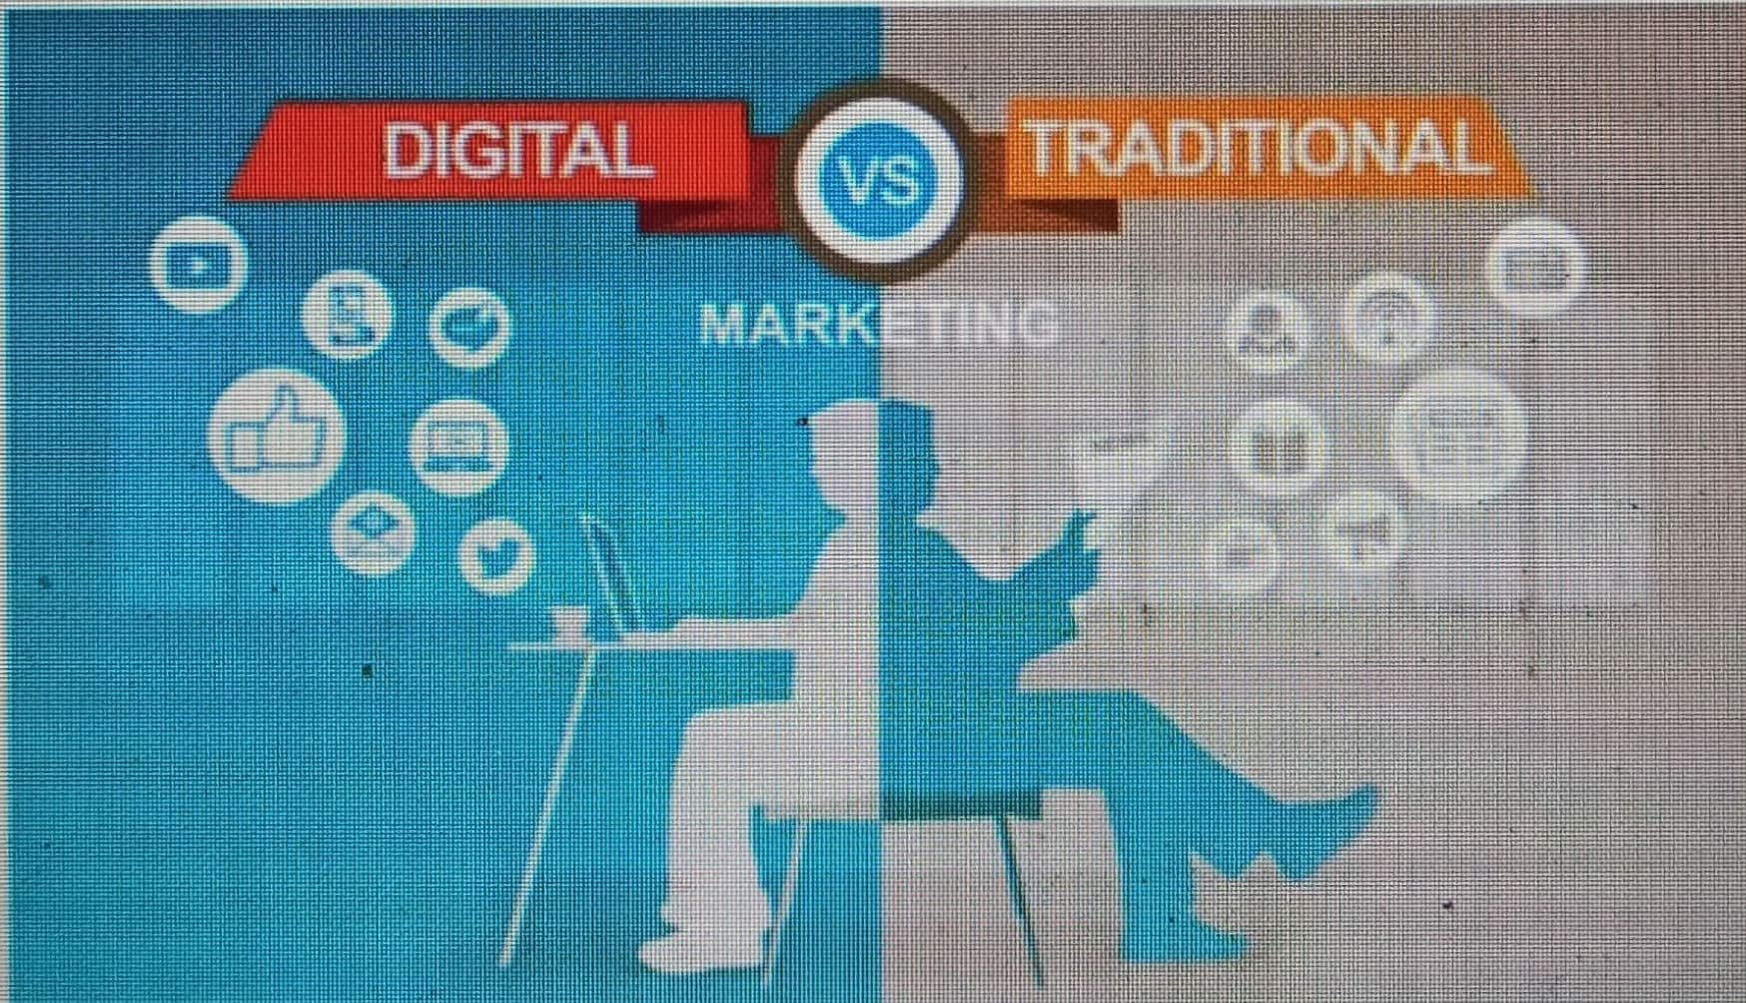

Slide 12
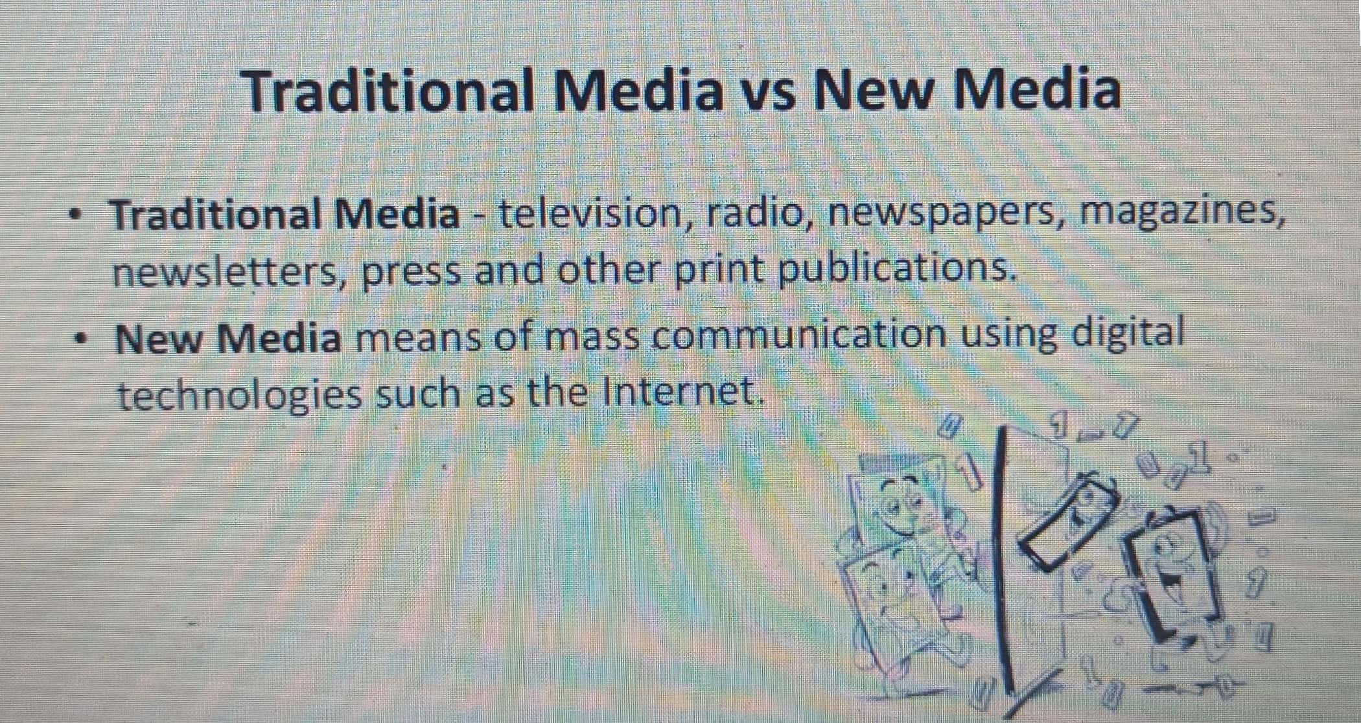

Slide 13
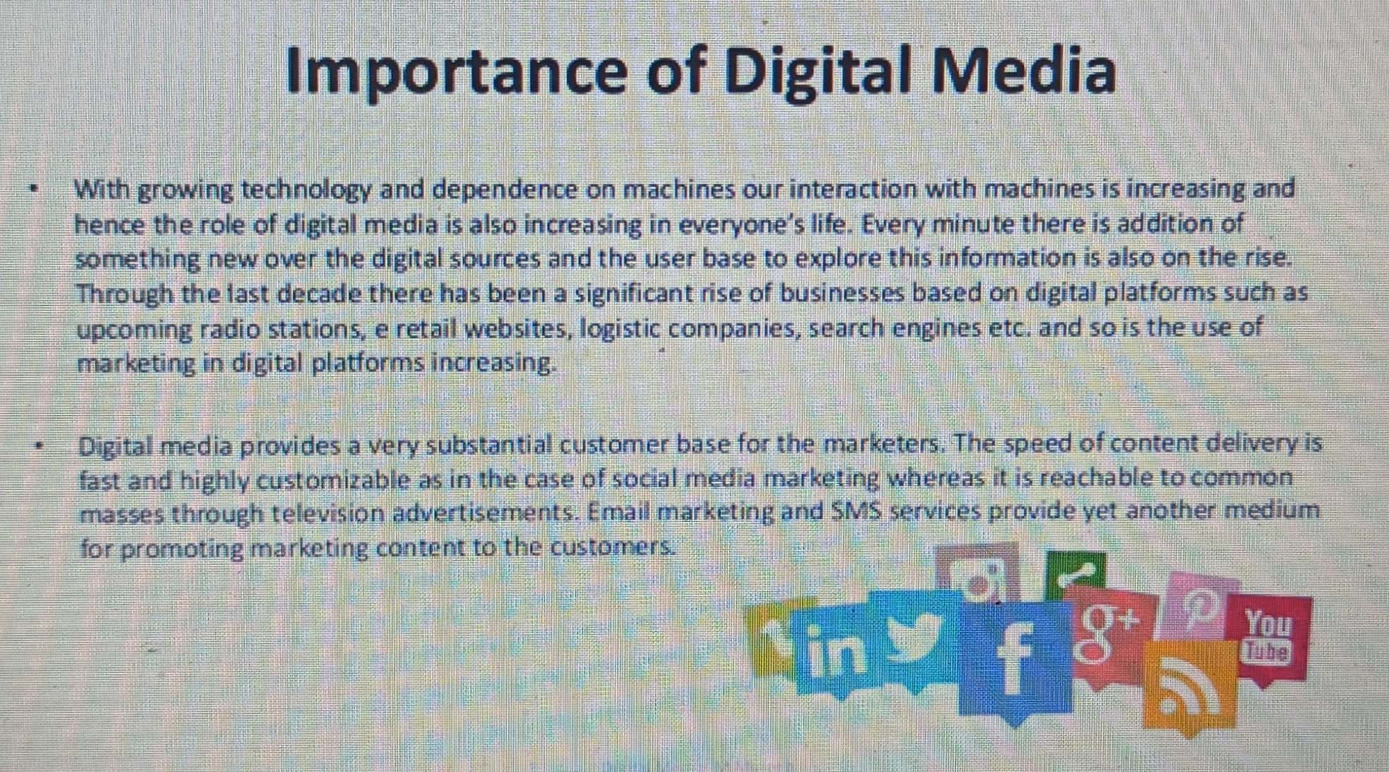

Slide 14
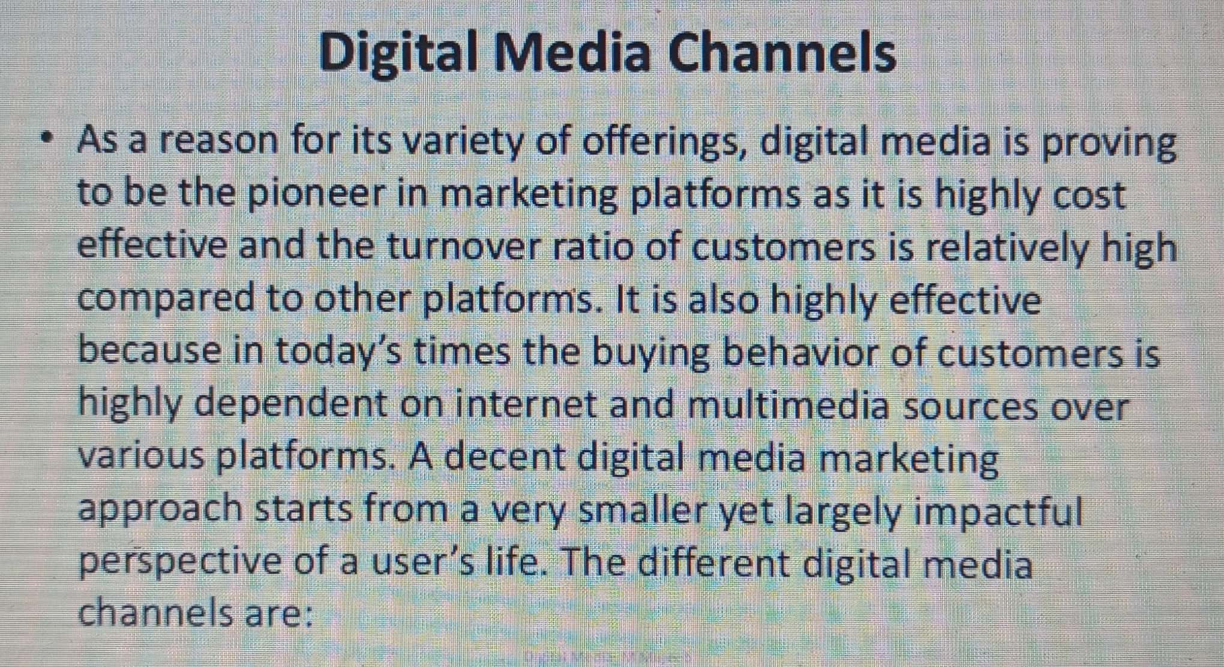

Slide 15
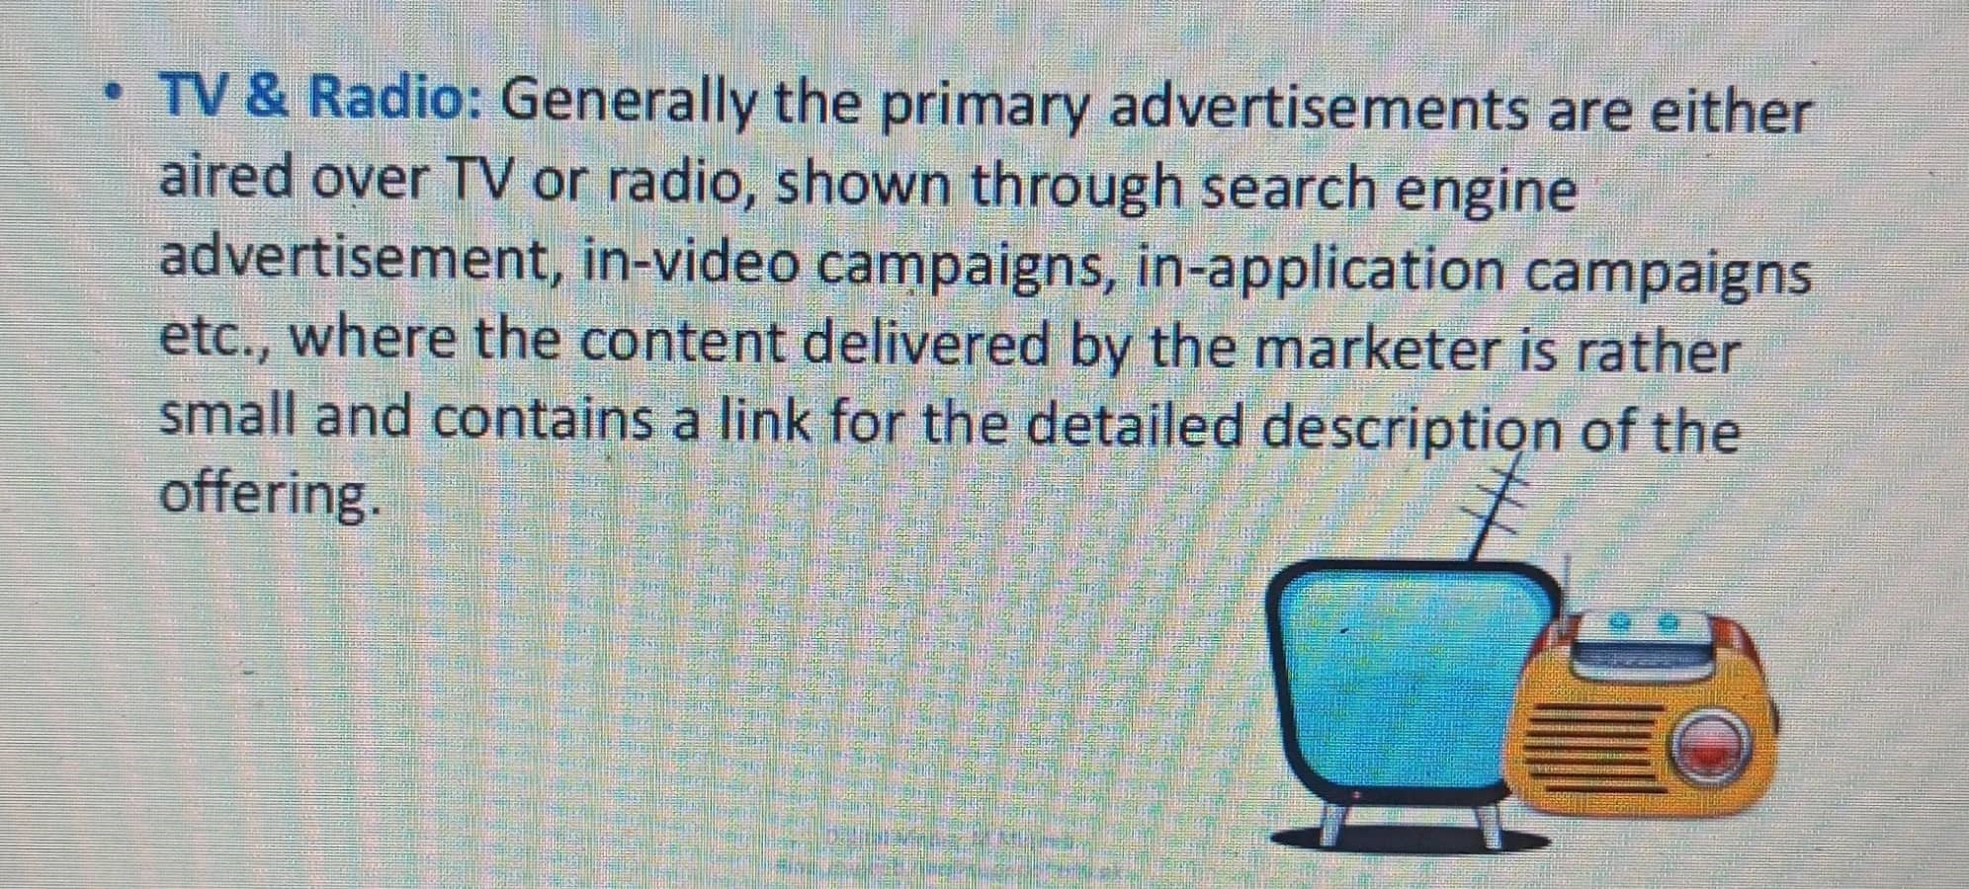

Slide 16
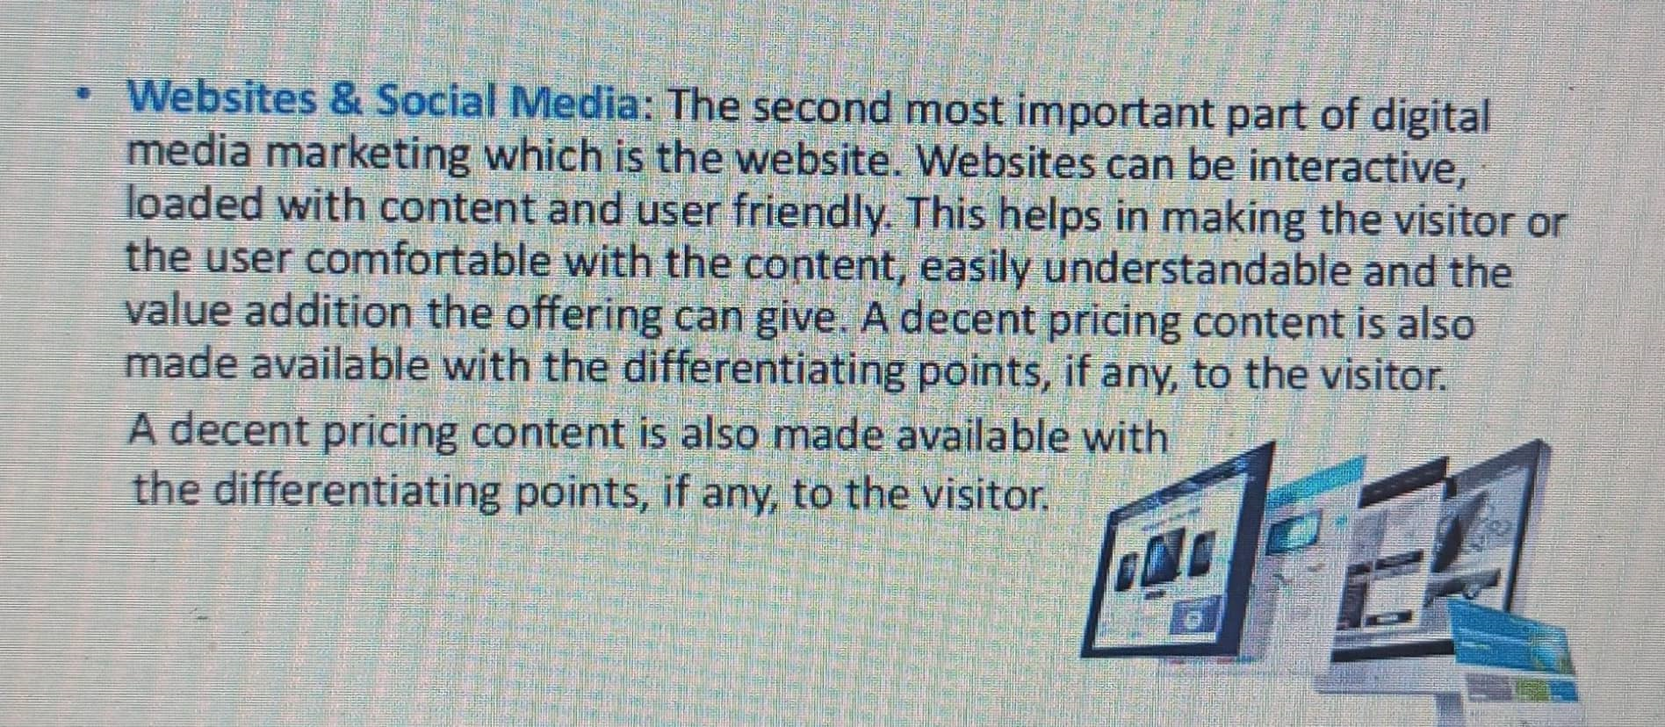

Slide 17
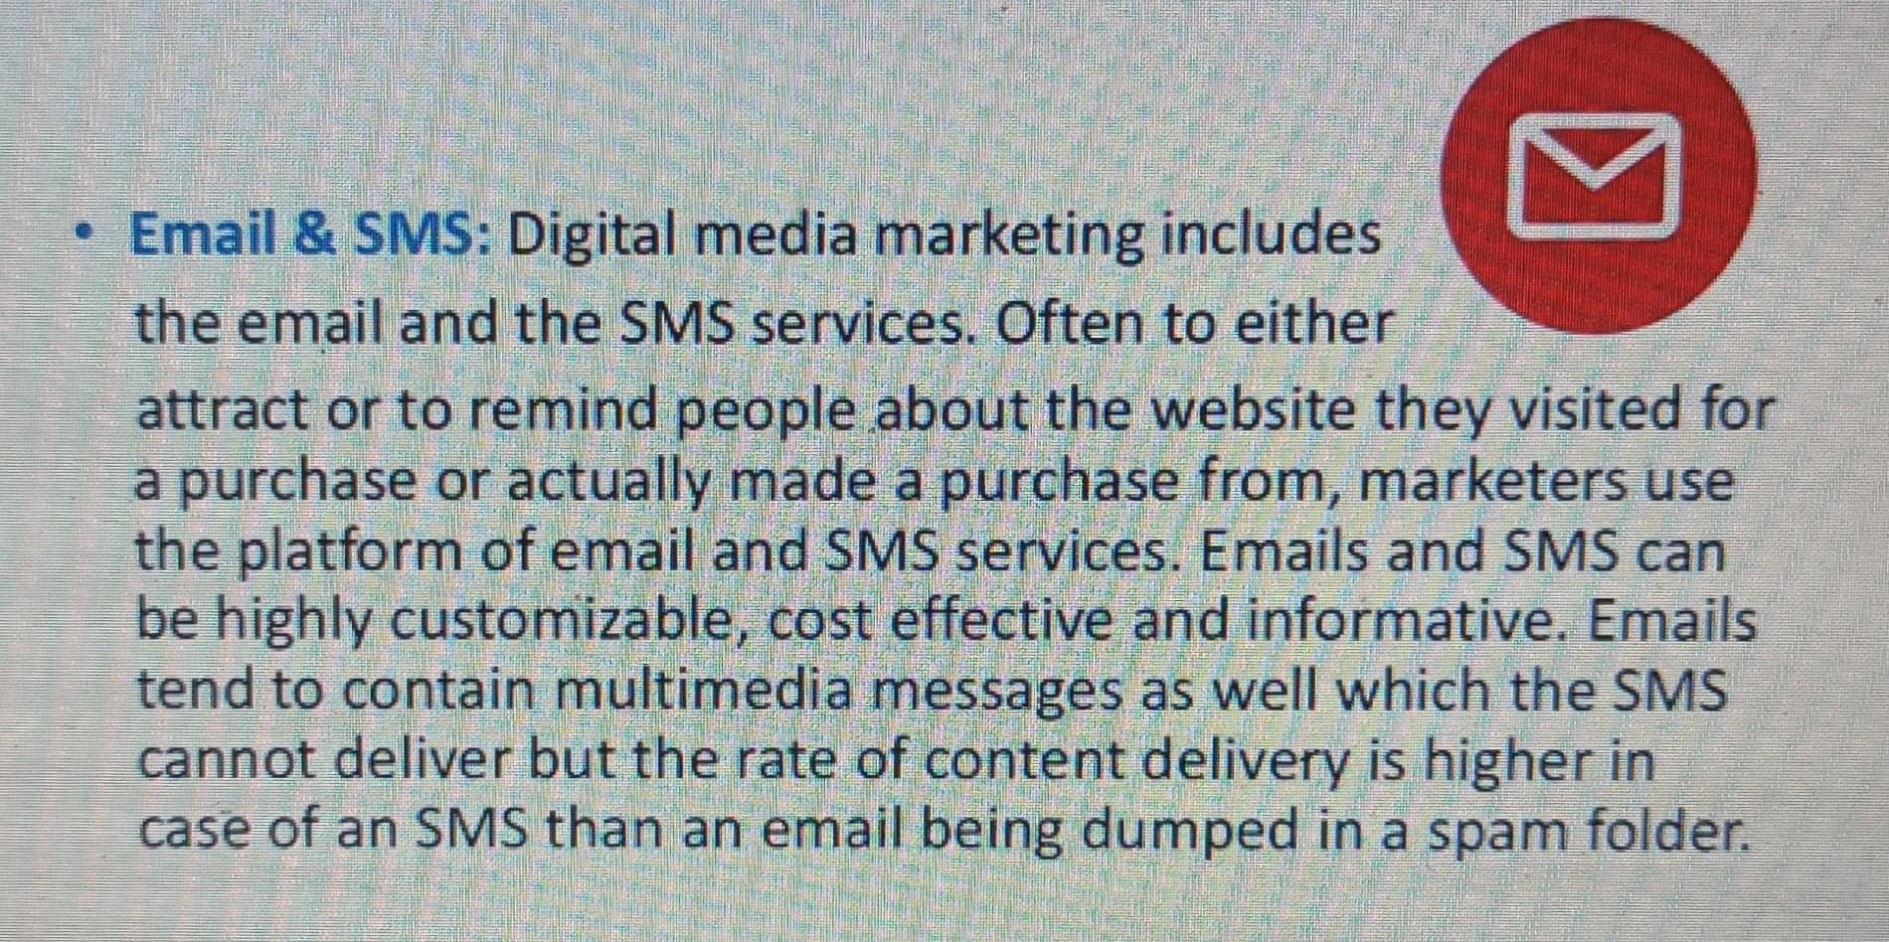

Slide 18
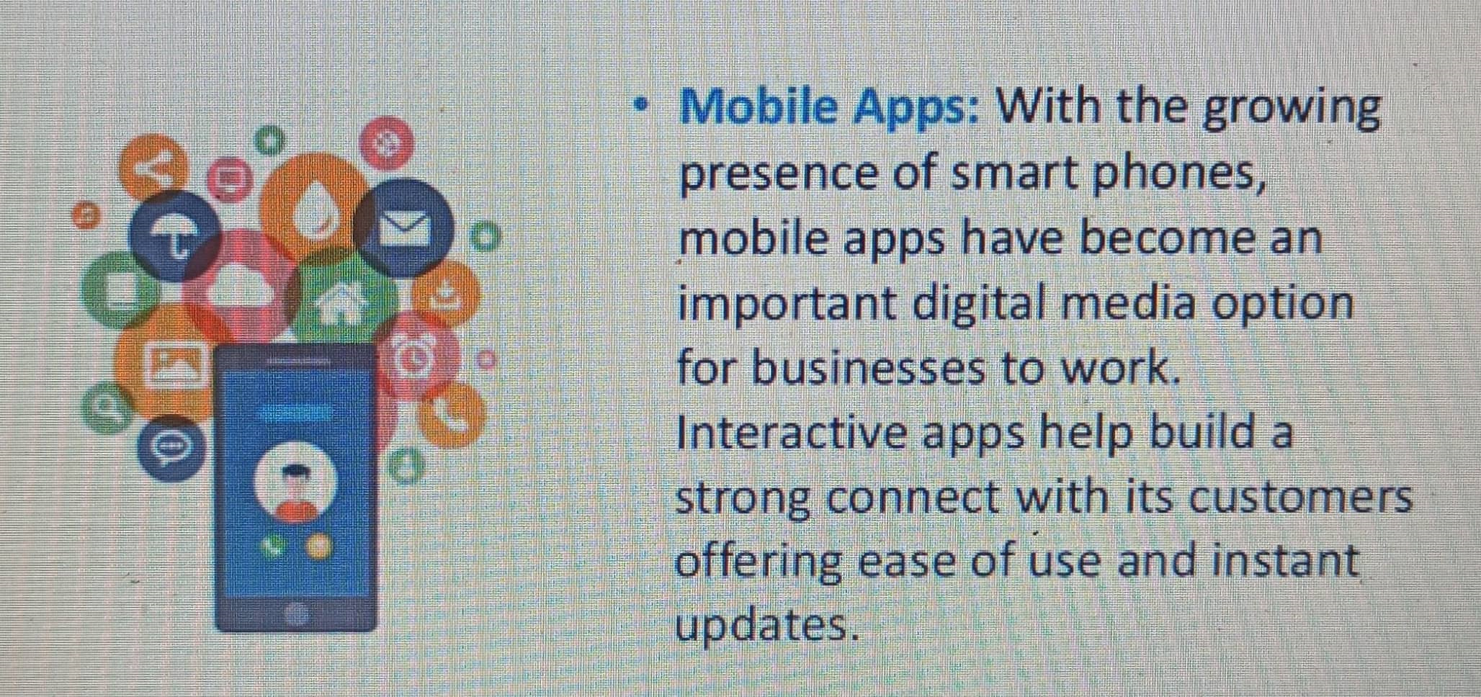

Slide 19
Reference and text books:-
TEXT BOOKS
Tay Vaughan, “Multimedia making it work”, Tata McGraw-Hill, 2008.
Rajneesh Aggarwal & B. B Tiwari, “Multimedia Systems”, Excel Publication, New Delhi, 2007.
Li & Drew, “Fundamentals of Multimedia”, Pearson Education, 2009.
REFERENCE BOOKS
Parekh Ranjan, “Principles of Multimedia”, Tata McGraw-Hill, 2007
Anirban Mukhopadhyay and Arup Chattopadhyay, “Introduction to Computer Graphics and Multimedia”, Second Edition, Vikas Publishing House.

Slide 20
Any query ??

Slide 21

Thank you

